Slide 1
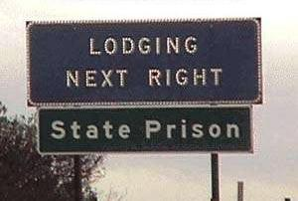
Overpopulated U.S. Prisons and their Financial Burden
Joseph Giovenco
Ricardo Castro
Andrew Babes

Slide 2
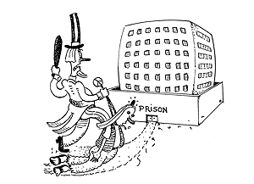
Prison Overpopulation Issues
*According to the American Civil Liberties Union the U.S. Prison Population is the highest of any world country: Over 2 million people.
*Federal, State, and local governments spent $24 billion last year on the incarceration on non-violent criminals alone. This is 50% more that the entire federal welfare budget, and almost six times the amount the federal government spends annually on child care.

Slide 3
Non-Violent Crimes Have Significantly Contributed To Our Prisons Over Population
*Over two thirds of the incarcerated individuals are there for non-violent drug related crimes or other non-violent offences (ACLU)
The American Civil Liberties Union of Texas states that Texas’s prisons have become too expensive because the majority of inmates are non-violent offenders who should be home supporting their families.

Slide 4
Prison Growth Compared to Prison Popuation
#348

Slide 5
Correlation Between Convicted and Incarcerated Criminals.
#339
There is little leigh way in terms of sentencing when mandatory minimums and other unfair sentencing guidelines are enforced.

Slide 6
Trends in
Non-Violent Crime over the past decade.
#325
Drug related offenses have increased 5% over the past decade, adding to the problem of prison overpopulation.

Slide 7
Eliminating the Unjust “War on Drugs” Is the Key to Eliminating Prison Overpopulation
The ACLU states that the sentences of many non-violent drug offenders are unjust. In 1990, more than half of the inmates serving mandatory minimums for drug offenses were first time offenders
According to the Farlex dictionary, large prison populations in the US are thought to result primarily from high incarceration rates, long sentences, and a rigidly fought “War On Drugs”
There is no known example of such policies successfully eradicating drug use or addiction.

Slide 8
Exactly why are people in Prison?
The total number of drug offenses from the list of serious crimes clearly outweighs all other crimes including violent crimes, which includes both rape and murder convictions

Slide 9
Estimated Predictions
The “War on Drugs” is clearly not effective because since its implementation drug related convictions have increased significantly. According to our predictions, drug related convictions will double by 2010.

Slide 10
A Policy of Rehabilitation instead of Incarceration
*Imprisoning an addict costs $25,900 per year, while treatment costs only $4400-6800 per year
*According to the ACLU, “we reach a point of diminishing returns when too many people are incarcerated; we continue to throw money at the situation by incarcerating the offender while no longer affecting public safety one way or the other."
*There has been no reduction in drug convictions because of incarceration because it does not solve the problem but reinforces it.

Slide 11
The projected number of convictions for non-violent drug offenses in the year 2010 would be 68,509…
at this rate the U.S. would be spending $1,774,383,100 on non-violent drug offenders alone.
We propose that instead of imprisoning these criminals, the U.S. should implement a drug rehabilitation program which would cost between $4400 and $6800 per year..
potentially saving the U.S. $1,418,136,300 in 2010.

Slide 12
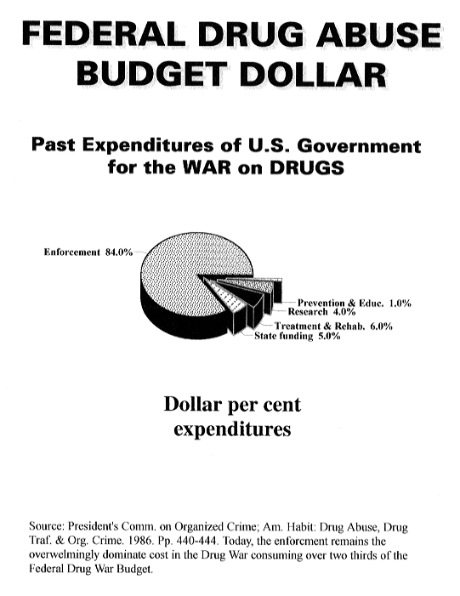

Slide 13
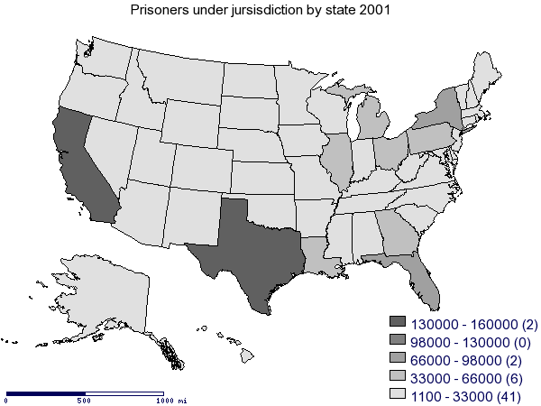
Where are people being convicted?

Slide 14
The potential for a federal drug treatment program.
According to Dr. Patrick Dixon The lack of treatment is particularly shocking in the light of some very encouraging results. A recent US survey found that substance abuse treatments:
Cut drug abuse by 50%
Reduced criminal activity by up to 80%
Increased employment
Decreased homelessness
Improved physical and mental health
Reduced medical costs
Reduced risky sexual behavior
Reduced drug injecting / needle sharing

Slide 15
In Conclusion
The U.S. prison population is the highest in the world
Over 2/3 of those incarcerated are non-violent drug offenders
Instead of incarcerating the individuals the government should enforce a mandatory drug rehabilitation program that would not only save the U.S. money but would decrease the number of repeat offenses.
The U.S. should also eliminate harsh sentencing guidelines such as mandatory minimums and California’s three strikes law.

